Slide 1
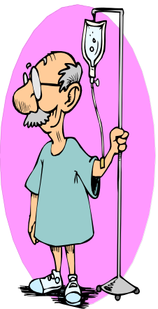

Fluids and Electrolytes
Water Balance and Sodium Disorders
Neela Bhajandas, PharmD.
Clinical Assistant Professor of Pharmacy
Neela.Bhajandas@temple.edu
Spring 2014

Slide 2
Sodium and Water Homeostasis
Human body tightly regulates blood volume and plasma osmolality
Homeostatic mechanisms controlling blood volume and plasma osmolality involve control of sodium and water
  Blood volume is important because it delivers oxygen and nutrients to tissues
  Plasma osmolality is an important determinant of intracellular volume.
    Intracellular volume is important in brain function

Slide 3
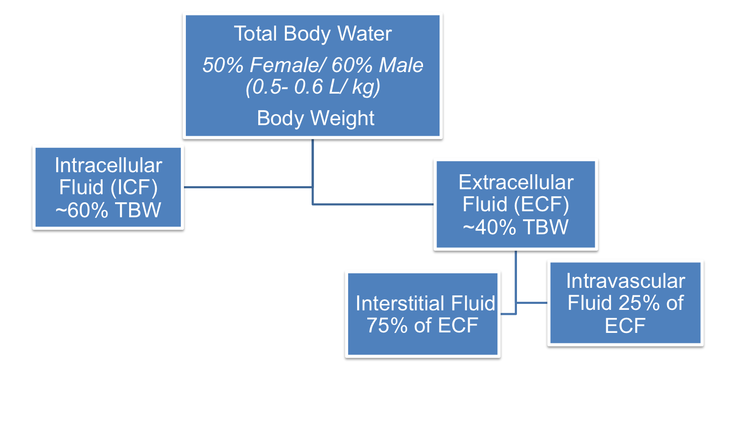
Body Fluid Compartment
Extracellular Fluid- contains the water and electrolytes located outside the cells (i.e. interstitial fluid, intravascular fluid (plasma)
Intracellular Fluid- contains the water and electrolytes located inside the cell
Interstitial Fluid- contains lymphatic fluid “bathes the cells” and fluid located between the tissues
Intravascular Fluid- contains blood, plasma, and fluid of the circulatory system which includes the heart and blood vessels
Notes:
----- Meeting Notes (1/30/14 11:53) -----
60% intracellular
40% extracellular
edema = fluid in interstitial space

Slide 4
Distribution of TBW
Water
ECF=
ECF (40% TBW)
Interstitial Fluid = 75% of ECF
Intravascular Fluid= 25% of ECF
Cell
ICF=
60% of TBW
40% TBW
ICF and ECF- separated by cell membranes which are highly permeable to water
Interstitial and Intravascular compartments- separated by capillary membrane
Notes:
----- Meeting Notes (1/30/14 11:53) -----
hypervolemic - fix intravascular
dehydrated - fix intracellular

Slide 5
Water Distribution Case #1
Weight= 198 lbs (90 kg) male
TBW= (60%) x (Weight (kg))
  ICF= 60% of TBW
  ECF= 40% of TBW
    Interstitial Fluid= 75% of ECF
    Intravascular Fluid= 25% of ECF
(60% x 90 kg) = 54 L
(60% x 54 L) = 32.4 L
(40% x 54 L) = 21.6 L
(75% x 21.6 L) = 16.2 L
(25% x 21.6 L) = 5.4 L

Slide 6

Water Distribution Case #1
Cell
ICF= 60% of TBW
54 L
ECF= 40% of TBW
Interstitial Fluid=
Intravascular Fluid=
ECF= 21.6 L
ICF = 32.4 L
16.2 L
4.5 L

Slide 7
Intavascular fluid compartment
ECF
Interstitial space
ICF
located inside the cell
ECF | Solute | ICF
140 | Sodium | 10
4 | Potassium | 150
2 | Magnesium | 40
105 | Chloride | 0
25 | Bicarbonate | 10
5 | Sulfate/phosphate | 150
*Electrolyte body fluid composition differs between the ECF and ICF
Notes:
ECF composition 140 comes from serum sodium concentration of 135- 145 mEq/L

Slide 8
Plasma Osmolality (Posm)
Osmolarity- # of particles/ Liter of water (mOsm/ L)
Osmolality- # of particles/ kg of a fluid (mOsm/kg)
  Posm (Normal range)= 280- 295 mg/ dL
  Calculated:
  ((2 x S_{Na}) + (glucose/18 mg/dL) + (BUN/2.8 mg/ dL)
  Na+ is the primary electrolyte located in the ECF and determines osmolality; Regulates fluid shifts between the intracellular and extracellular compartment
  Extreme variation in osmolality cause cells to shrink or swell, damaging or destroying cell structure
Tonicity- # of particles found in a solution
  Osmolarity is most often used when referring to blood and tonicity is most often used when referring to IV Fluids

Slide 9
Regulation of Water Balance
Water is regulated in our body by Antidiuretic Hormone (ADH) also known as vasopressin and a thirst mechanism
  Intake primarily regulated by the thirst mechanism
  Output primarily regulated by ADH
    ADH; Vasopressin
 | Water intake | Water output
Sources | Drinking Food Water generated from oxidation | Urine Skin Respiratory tract Stool

Slide 10
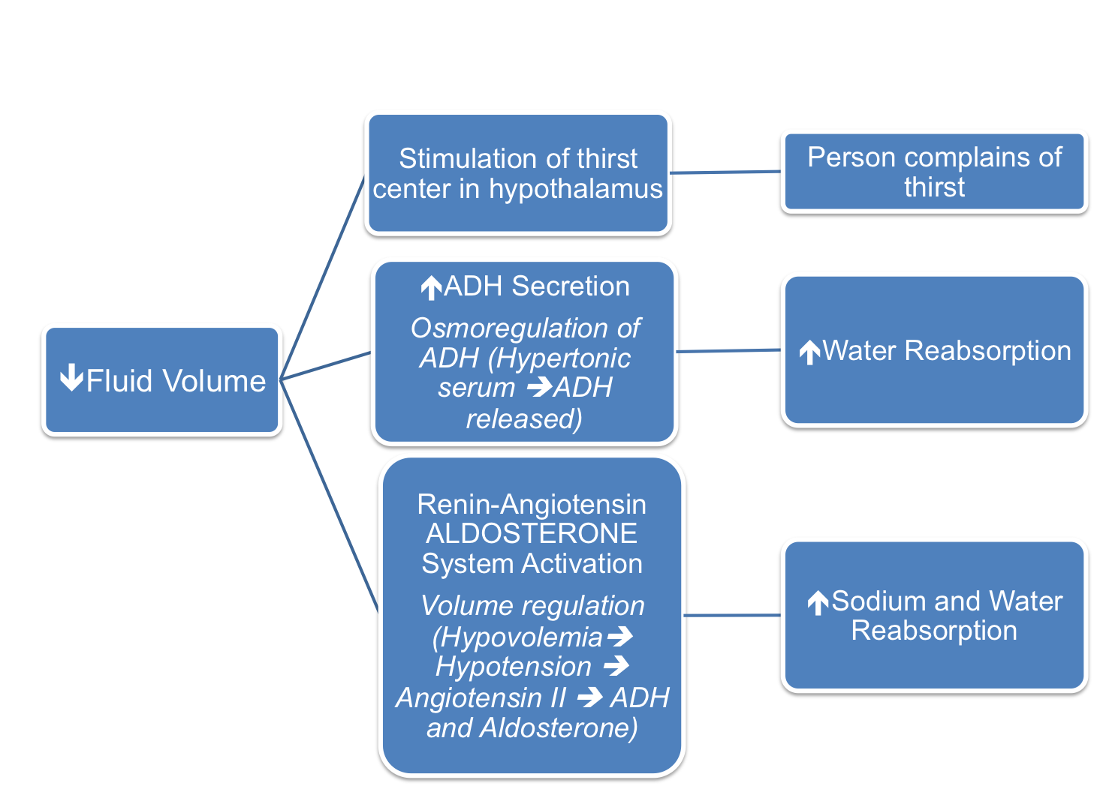
Regulation of Water Balance
May occur as a result of:
⬇Fluid intake
Loss of body fluids
Compartmentalization of body fluids

Slide 11
Regulation of Water Balance
Regulation of water intake
  Thirst mechanism is the primary regulator of water intake and derives from the osmotic pressure of ECF and the thirst center in the hypothalamus
  Once water is taken in the resulting distension of the stomach will inhibit the thirst mechanism
Regulation of water output
  The distal convoluted tubules and collecting ducts regulate water output
  ADH causes a reduction in the amount of water lost in the urine
  When water intake is adequate, the ADH mechanism is inhibited and more water is expelled in the urine

Slide 12
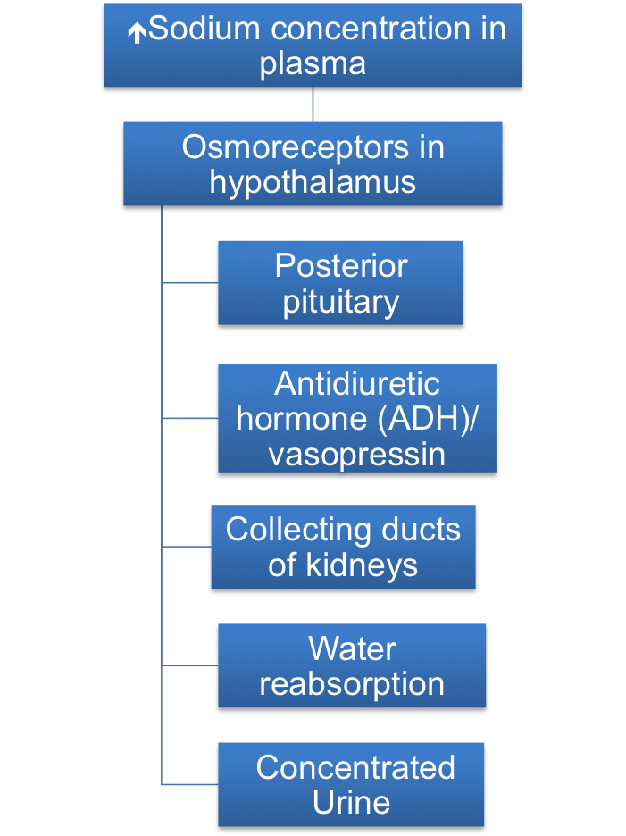
Regulation of Water Balance
Stimulates
Stimulates
ADH
Water
Releases
ADH
Water
Concentrated Urine
Results
Water

Slide 13
Administration Route for
Fluid Replacement Therapy
Oral Route | PO ingestion of fluids and electrolytes administered directly into the GI tract
Nasogastric Route | Instillation of fluids and electrolytes through feeding tubes such as a nasogastric tube (NGT), gastrostomy, and jejunostomy tube
IV Route | Administration of fluids and electrolytes directly into the bloodstream using a continuous infusion, IV push injection through peripheral or central venous site

Slide 14
Fluid Losses
Site | Na+ (mEq/L) | K+ (mEq/L) | Cl- (mEq/L) | HCO3- (mEq/L)
Nasogastric | 40-64 | 10 | 100-140 | minimal
Urine | 80 | 40 | - | -
Pancreas | 120-140 | 5-15 | 90-120 | 60-115
Small intestine | 135-140 | 5-15 | 90-130 | 30-40
Diarrhea | 25-50 | 35-60 | 20-40 | 30-60
*Important because if a patient is losing fluids through one of these mechanisms, it will change the type of IV fluid that we would recommend for them because we want to mimic and replete the electrolytes that the patient is losing
Notes:
----- Meeting Notes (1/30/14 11:53) -----
NS has 154 mEq/L

Slide 15
Maintenance IV Fluid Management
Replaces ongoing losses of water and electrolytes under normal physiologic conditions
  i.e. Urine, sweat, respiration, stool
  Required for patients unable to take anything by mouth (NPO)
Goal: Maintain urine output > 0.5-1.0 mL/kg/hour
  Prevent dehydration
Fluids used:
  0.45% Sodium Chloride (1/2 NS)
  Dextrose 5%/ 0.45% Sodium Chloride (D5/ ½ NS ) +/- KCL

Slide 16
Calculation of Maintenance Fluids
Holiday-Segar Method
Calculation of maintenance fluid/ 24 hours
  100ml/kg for the 1st 10 kg
  50ml/kg for the next 10 kg
  20ml/kg for anything over 20 kg
Replacement fluid
  Volume losses need to be accounted for when estimating maintenance fluids
  Add 10% for each degree of body temperature (37° C)
  Add extra for fluid losses (GI (vomiting, diarrhea), skin losses (burns), fevers, NGT etc.)
Needs to be reassessed daily
Notes:
----- Meeting Notes (1/30/14 11:53) -----
**Know Holiday-Segar Method**
**know 10% for each degree over 37*C **

Slide 17
Case #2
JS is a 64 y/o male (89 kg) who is admitted to TUH for a cholecystectomy. JS is going to be NPO x 3 days and the surgery resident calls the pharmacy and wants to know what rate to run the IV fluid (mL/hour) and what type of IV fluid to order?
Notes:
----- Meeting Notes (1/30/14 11:53) -----
1500 + (69*20) = 1500 + 1380 = 2880 mL/day
120 mL/hr

Slide 18
Case #2 continued
Two days later JS’ temperature increases to 39°C. What will his new IV fluid rate be (mL/ hour)?
Notes:
----- Meeting Notes (1/30/14 11:53) -----
120 mL/hr
39 - 37 = 2 degrees
12*2 = 24 mL/hr extra
120 + 24 = 145 mL/hr

Slide 19
Case #3
TM is a 27 y/o male admitted for a GSW, three days ago, to the abdomen and LLE. Overnight, TM developed severe abdominal pain, distension, N/V/D. He was taken to the OR for an emergency sub-total colectomy. Post-op his nasogastric tube (NGT) losses were > 2.5 liters.
What IV fluid would be most appropriate to replace his NGT output?

Slide 20
Disorders of Fluid Balance
 | Concentration | Volume
Fluid imbalance disorder | ICF volume | ECF volume
Fluid Balance Disorder Decreased Fluid Excess Fluid | Dehydration Water intoxication | Hypovolemia Hypervolemia

Slide 21
Disorders of Fluid Balance Relating to Concentration
 | Concentration
Fluid imbalance disorder | ICF Volume
Disorder | *Dehydration Water intoxication
Causes | Dehydration | Water intoxication
 | Decreased water intake Diarrhea Heat-related | Increased water intake
 | Dehydration is relatively easy to prevent and replace because onset is slower than hypovolemia

Slide 22
Dehydration
Usually a result of ICF volume depletion
Dehydration alters tonicity
Results from water deficiency
Causes of dehydration
  Decreased water intake
  Diarrhea
  Heat-related
Onset slower than hypovolemia, relatively easy to prevent and replace

Slide 23
Treatment of Dehydration
Can be managed as an outpatient in adults
Supplemental fluids can be added to normal daily requirements
Can use oral rehydration formulas

Slide 24
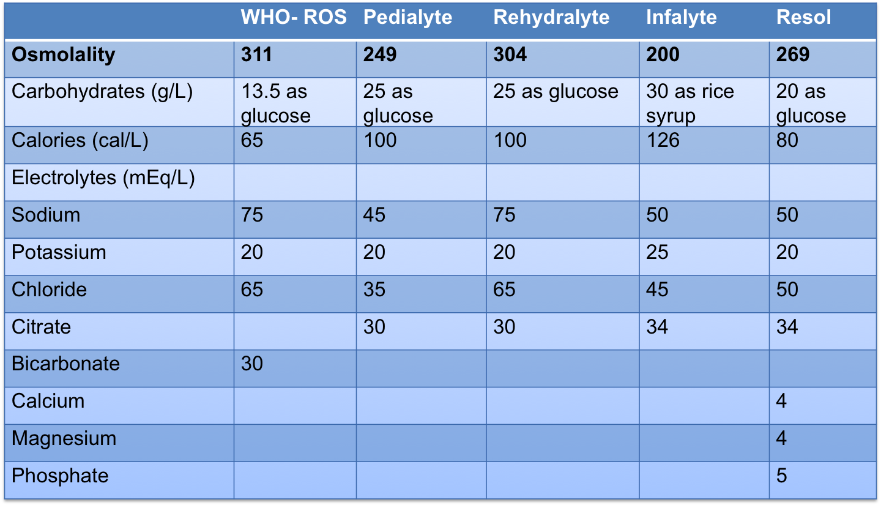
Oral Rehydration Solutions
*Try to keep osmolality similar to our normal serum osmolality
Dextrose and sodium co-transport absorption

Slide 25
Disorders of Fluid Balance Relating to Volume
 | Volume
Fluid imbalance disorder | ECF Volume
Disorder | Hypovolemia Hypervolemia
Causes | Hypovolemia | Hypervolemia
 | Hemorrhage/Blood loss Loss of plasma volume Thermal Injury Third spacing Severe dehydration | Renal Failure Decompensated HF Cirrhosis
 | Hypovolemia can lead to shock, ischemia, and death if not treated quickly
Notes:
0000

Slide 26
Hypovolemia
Relates to the extracellular fluid (ECF)
  Specifically intravascular sodium and water loss
Can cause a decrease in tissue perfusion resulting from circulatory failure
Can lead to shock and death if not treated quickly
Notes:
----- Meeting Notes (1/31/14 09:16) -----
hypovolemia = intravascular space

Slide 27
Clinical Manifestations of Hypovolemia
Causes of Hypovolemia
  Hemorrhage/ Blood Loss
  Loss of plasma volume
  Thermal Injury
  Third spacing
  Severe dehydration
⬇ Perfusion to our organs
Brain
Lethargy
Stupor, coma
Kidneys
⬆ SCr
⬇ Urine output
Extremities
Cold extremities
⬇ Skin Turgor
Body trying to compensate
⬆ HR
⬆ RR
⬇ BP

Slide 28
Treatment of Hypovolemia
Hospitalization is indicated
  Large-bore peripheral IV access or a central line should be obtained
Fluids used:
  Treat with Isotonic crystalloids (first line treatment): Lactated Ringer’s IV or Normal Saline IV as fast as possible until response in adult, then decrease rate of infusion
  Give until signs/symptoms start to resolve
    (i.e. mental status, increase urine output, vital signs start to normalize)
  Can also use colloids as second line treatment
  Will likely need blood cell replacement if hemorrhagic
Notes:
----- Meeting Notes (1/31/14 09:16) -----
Hypovolemia - Intravascular
tx: Lactaed Ringers and NS

Slide 29
Hypervolemia
Caused by retention of sodium due to
  Defect in renal sodium excretion
  Expansion of ECF volume
Renal failure, decompensated HF, cirrhosis
Clinical manifestations (Fluid overload)
  Edema
  Pulmonary edema
  Anasarca
  Weight gain
Treatment
  Diuretics
    Loop diuretics most potent

Slide 30
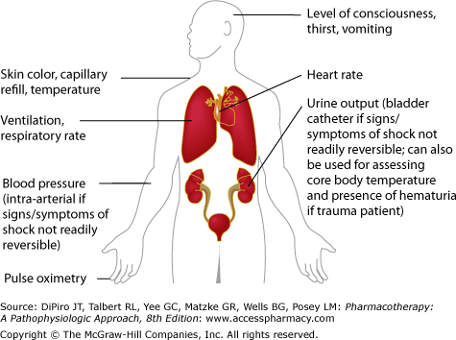
Monitoring for Disorders of
Fluid Balance

Slide 31
Clinical Manifestations of Water Balance
 | Dehydration | Hypovolemia
BP | Normal | Decreased
Quality of pulses | Normal | Moderately decreased
HR | Normal | Increased
Skin turgor | Normal | Decreased
Mucous membranes | Slightly dry | Dry
Extremities | Warm, normal capillary refill | Cool, mottled
Mental status | Normal (but can have a change in mental status) | Normal to lethargic or comatose
Urine output | Slightly decreased | X < 0.5 mL/kg/hr
Thirst | Slightly increased | Very thirsty
Fluid replacement | Oral Rehydration Fluids (IV Rehydration D5W (overestimated) | Lactated Ringers IV Normal Saline IV
Adapted from Dipiro’s Pharmacotherapy 8th ed.
*Clinical assessment of degree in dehydration in children
(Mild dehydration- 3- 5% extrapolated to dehydration in adults vs.
severe dehydration ≥ 10% extrapolated to hypovolemia in adults)
Notes:
----- Meeting Notes (1/31/14 09:16) -----
*****know****
Hypovolemia < 0.5 mL/kg/hr

Slide 32
Tonicity
H2O in = H20 out
H2O out
H2O in
Cell
Cell
Cell
Hypertonic IV Fluid
Isotonic IV Fluid
Hypotonic IV Fluid
IV fluids can be classified by their osmolality relative to plasma
 | Tonicity | Fluid shifts | mOsm
Isotonic Fluid | Same tonicity | No shift (ECF= ICF) | 280- 310
Hypotonic Fluid | Low tonicity (lower concentration of solute) | Fluid moves from ECF ➔ ICF | < 280
Hypertonic Fluid | High Tonicity (higher concentration of solute) | Fluid moves from ICF ➔ ECF | > 310
Notes:
IV fluids can be classified by their osmolality relative to plasma
Isotonic fluid will not result in a fluid shift between fluid compartments because the osmolality is similar to plasma
Hypotonic fluid can cause fluid to shift from the EC to the IC compartment with cell swelling (i.e. hemolysis, cerebral edema and herniation)
Hypertonic fluid can cause fluid to shift from the IC to the EC compartment causing cell shrinkage

Slide 33
IV Parenteral Fluids: Plasma Expanders
Crystalloids
Colloids
Isotonic
  Lactated Ringers (LR)
  0.9% Normal saline (NS)
Hypotonic
  *5% Dextrose in water (D5W)
  0.45% Saline (1/2 NS)
  <0.45% Saline (x< ½ NSS)
    i.e. 0.225% saline (1/4% saline, 1/4NSS)
Hypertonic
  3% Saline (3% NaCl)
Albumin 5% and 25%
Hydroxyethylstarch (Hetastarch)
Dextran
Blood/ Blood products
Notes:
16:50

Slide 34
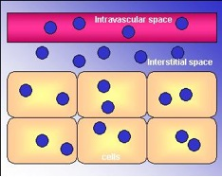
Isotonic Crystalloids
Isotonic because the osmolality is similar to what is physiologically normal to us
~25% remains intravascularly
  Lactated Ringers (LR)
  0.9% NaCl
Expands the intravascular compartment
  Plasma expander
Indications
  Hypovolemia
Intravascular space
ECF
Interstitial space
ICF
Cells
Notes:
18:00

Slide 35
Administering ISOtonic Fluid
ECF
[Na]
Isotonic Fluid
(0.9% NaCl) IV
ICF
 | 1 L (1000 mL) of 0.9% NaCl
ECF (Interstitial) | 750 mL
ECF (Intravascular) | 250 mL
Interstitial space
Intravascular space
Notes:
19:00

Slide 36
Isotonic Crystalloids Adverse Reactions
Lactated Ringers
Fluid overload
Hyponatremia
hyperkalemia
0.9% Normal Saline
Fluid overload
Hypernatremia
Hyperchloremic metabolic acidosis
Solution | Dextrose (gm/dl) | Na+ (mEq/L) | Cl- (mEq/L) | Other | mOsm/L | Tonicity
Lactated Ringers (LR) | 0 | 130 | 109 | 4 mEq/L K+, lactate, calcium | 273 | Isotonic
0.9% saline (NS) | 0 | 154 | 154 | 0 | 308 | Isotonic

Slide 37
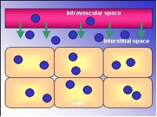
Hypotonic Crystalloids
Hypotonic fluid can cause fluid to shift from the intravascular space to the intracellular (ICF) space with subsequent cell swelling
  i.e. hemolysis, cerebral edema and herniation
Only ~10% remains intravascularly
therefore inadequate for fluid
resuscitation
Hypotonic
  5% Dextrose in Water (D5W)
    Does not contain sodium
  0.45% Saline (1/2 NS)
  <0.45% Saline (x< ½ NSS)
    (i.e. 0.225% saline (1/4% saline)
    ¼ NS is NOT recommended by itself b/c it’ll make patient hyponatremic
Cells
Notes:
26:00

Slide 38
Administering HYPOtonic Fluid
ECF
[Na]
Hypotonic Fluid
(0.45%NS) IV
ICF
 | 1000 mL of 0.45% NaCl
ECF (Interstitial) | ~300 mL
ECF (Intravascular) | ~100 mL Losing water going into ICF
Interstitial space
Intravascular space

Slide 39
Administering D5W IV Fluid
ECF
[Na]
D5W (free water) IV
ICF
 | 1000 mL of D5W
ICF | 600 mL
ECF (Interstitial) | 300 mL
ECF (Intravascular) | 100 mL
Interstitial space
Intravascular space

Slide 40

Hypotonic Saline
Adverse Reactions
D5W
½ NS
< ½ NS (i.e. ¼ NS)
< ½ NS (i.e. ¼ NS)
Should NEVER be used by itself. Should add something to it to increase the osmolality (i.e. D51/4NS)
Solution | Dextrose (gm/dl) | Na+ (mEq/L) | Cl- (mEq/L) | Other | mOsm/L | Tonicity
5% dextrose in water (D5W) | 5 | 0 | 0 | 0 | 252 | Hypotonic
0.45% saline (1/2NS) | 0 | 77 | 77 | 0 | 154 | Hypotonic

Slide 41
Hypertonic Saline
Sodium Chloride 3%
  Commercially available in other concentrations but most commonly used is 3% NaCl
HIGH ALERT MEDICATION
  Highly Hypertonic
    Contains 513 mEq/ L of Na+ and 513 mEq/L of Cl-
    Should NOT be administered via peripheral line because of its tonicity
Must be administered via central line
Indications
  Traumatic brain injury
  Use when Severe SYMPTOMATIC hyponatremia
Cells

Slide 42
Administering HYPERtonic Fluid
ECF
[Na]
Hypertonic Fluid
(3% NaCL) IV
ICF
 | 1000 mL of 3% NaCl
Interstitial | 750 mL
Intravascular | 250 mL + water from ICF
Interstitial space
Intravascular space

Slide 43
Hypertonic Saline Adverse Reactions
Hypertonic Saline (3% NaCL)
  Hypernatremia
Solution | Dextrose (gm/dl) | Na+ (mEq/L) | Cl- (mEq/L) | Other | mOsm/L | Tonicity
3% saline hypertonic | 0 | 513 | 513 | 0 | 1026 | Hypertonic
Notes:
36:45

Slide 44
IV Crystalloids Fluid Components
Solution | Dextrose (gm/dl) | Na+ (mEq/L) | Cl- (mEq/L) | Other | mOsm/L | Tonicity
5% dextrose in water (D5W) | 5 | 0 | 0 | 0 | 253 | Hypotonic
0.45% saline (1/2NS) | 0 | 77 | 77 | 0 | 154 | Hypotonic
0.9% saline (NS) | 0 | 154 | 154 | 0 | 308 | Isotonic
3% saline hypertonic | 0 | 513 | 513 | 0 | 1026 | Hypertonic
Lactated Ringers (LR) | 0 | 130 | 109 | 4 mEq/L K+, lactate, calcium | 273 | Isotonic
Isotonic IV solutions have an osmolarity between ~280- 310 mOsm/L

Slide 45
Distribution of crystalloids:
Indicate if sodium ↑, ↓, or ↔
Indicate which direction water will be moving
[Na]
ECF
H20
ICF
[Na]
ECF
H20
ICF
5% dextrose
0.9% NaCl
[Na]
ECF
H20
ICF
[Na]
ECF
H20
ICF
3% NaCl
0.45% NaCl
When administered IVF, Na dose not increase until given multiple liters
Notes:
Administering IVF does not increase until given multiple liters

Slide 46
Crystalloids vs. Colloids
Crystalloids | Colloids
Contains Na+ as the main osmotically active particle | Contains Na+ as an osmotically active particle
Utilized for volume expansion and maintenance | Utilized for volume expansion Draws fluid from the interstitial space into the vascular compartment. *Works well in reducing edema while expanding the vascular compartment
Na+ and Cl- does NOT freely cross into the cells (ICF), but will distribute in the ECF compartment (interstitial and intravascular fluid) | Does NOT cross into the cells. Too large to cross the capillary membrane; therefore initially remains primarily in the intravascular space of the ECF
Utilized for correction of electrolyte abnormalities (Na+)
 | $$$$
Notes:
41:30
Volume expansion- hypovolemia
Maintenenace d5 ½ NS

Slide 47
Colloid Solutions
Albumin
  Albumin 5% and 25%
Hydroxyethylstarch
  Hetastarch
Dextran
  Dextran 40, 70, and 75
Blood/ blood products
  Packed red blood cells (PRBCs), Fresh-frozen plasma (FFP), platelets
Plasma Expanders
Notes:
High Alert Medication

Slide 48
Colloids
Larger molecular weight solutions corresponds with intravascular retention time
  Colloids are too large to cross the capillary membrane; therefore they will remain in the intravascular space
Useful for volume expansion (hypovolemia)
Expensive $$$
SAFE (Saline vs. Albumin Fluid Evaluation) Study (NEJM 2004;350:2247-56)
  A comparison of albumin and saline for fluid resuscitation in the intensive care unit
  Showed no difference in outcomes in
  hypovolemic patients 28 days
    No difference in how quickly the patients’
    volume status normalized and no difference in mortality
Cells

Slide 49
Adverse Reactions of
Plasma Expanders: Colloids
 | Albumin | Hydroxyethylstarch | Dextran
Fluid overload | X | X | X
Anaphylaxis reactions | X | X | X
Infectious complications | X (rare)
Renal dysfunction | X (Albumin 25%) | X | X
Bleeding |  | X | X
Pruritus |  | X
 | -5% isooncotic -25% hyperoncotic -Dilution of Albumin 25% should be avoided

Slide 50
Colloid Solutions
Solution | Na+ (mEq/L) | Cl- (mEq/L) | Available formulations | mOsm/L
6% Hetastarch | 154 | 154 | Per 500 mL | 310
5% Albumin | 130-160 | 130-160 | Per 250-500 mL | 330
25% Albumin | 130-160 | 130-160 | Per 50- 100 mL | 330

Slide 51
Fluid Distribution and Indications
Fluid | Intracellular | Interstitial | Intravascular | Major Indication
D5W | 667 mL | 250 mL | 83 mL | Dehydration
D51/2NS | 333 mL | 500 mL | 167 mL | Maintenance fluid
NS LR | 0 | 750 mL | 250 mL | Intravascular repletion in symptomatic patients
3% NaCL | 0 | 750 mL | 250 mL + | Severe SYMPOTOMATIC hyponatremia
Albumin 5% |  |  | 1000 mL | Intravascular repletion for symptomatic patients with fluid restriction
Adapted from DiPiro’s Pharmacotherapy 8th ed.

Slide 52
Case #4
JC is a 29 y/o male admitted for a GSW to the abdomen and LLE. Upon admission to the ED JC’s vital signs are as follow:
BP 89/30 HR 135 Hemoglobin: 5.9 gm/dL
  What type of fluid disorder is this patient most likely suffering from?
  What signs and symptoms does JC display?
Notes:
3:20
Hypovolemia
Low BP, increase HR, low Hgb
Tx: NS

Slide 53
Case #5
CM is an 87 y/o female transferred to TUH from a nursing home for a 5 day history of diarrhea, poor oral intake, and a change in mental status.
  What type of fluid disorder is CM suffering from?
  What signs and symptoms are characteristic of CM’s fluid disorder?
Notes:
Dehydration
s/s: change in mental status, diarrhea

Slide 54
Case #6
AW is a 34 year old male brought in by fire rescue after being found unconscious in a house fire. He has suffered 65% BSA burns.
Upon admission his vital signs are as follows:
BP 70/45 HR 136 RR 40 Temp 33° C
He has produced 50 mL of urine over the last 4 hours. The Burn ICU attending would like to start IV fluids for hypovolemic shock.
  What IV fluids would be appropriate to start in this patient?
  What monitoring parameters would you follow?
Notes:
7:30
NS or lactaed ringers
Monitor: BP, HR, RR, Temp, Urine output (goal > 0.5 mL/kg/hr)

Slide 55
Fluids and Electrolytes
Sodium Homeostasis
Neela Bhajandas, PharmD.
Clinical Assistant Professor of Pharmacy
Neela.Bhajandas@temple.edu
Spring 2014

Slide 56
Sodium
Sodium Na+ (135- 145 mEq/L)
Na+ is the most abundant extracellular cation and major osmotically active substance in the ECF
  Water always follows sodium
  Changes in serum sodium concentration usually reflect changes in water balance; however total body sodium concentration may be ↑, ↓, or ↔
  Volume status must ALWAYS be assessed in patients presenting with sodium disorders

Slide 57
Sodium disorders
Hyponatremia
  Isotonic
  Hypertonic
  Hypotonic
    Hypovolemic
    Hypervolemic
    Euvolemic
Hypernatremia
  Hypertonic
    Hypovolemic
    Hypervolemic
    Euvolemic

Slide 58
Hyponatremia

Slide 59
Disorders of Hyponatremia
Assess sodium
Assess plasma osmolality
  Usually Low (Hypotonic)
Clinically assess patient volume status
  Low: Hypovolemic hyponatremia
  Normal: Isovolemic hyponatremia
  High: Hypervolemic hyponatremia

Slide 60
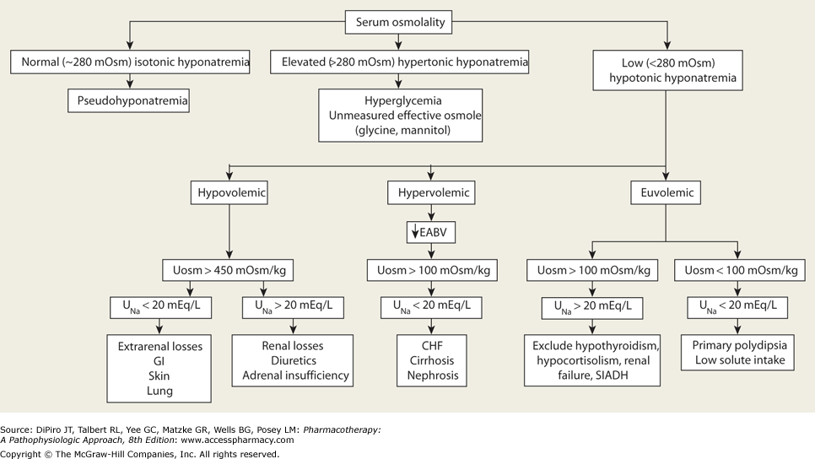
Diagnostic algorithm for the evaluation of hyponatremia
*Hyponatremia is associated with ↑, ↓, or ↔ plasma osmolality depending on its cause
Notes:
13:00

Slide 61
Isotonic hyponatremia
Isotonic hyponatremia: (Pseudohyponatremia)
  Causes
    Hyperlipidemia or hyperproteinemia
  Rare/ uncommon with new lab techniques to measure serum sodium (lab abnormality)

Slide 62
HYPERTONIC hyponatremia
Diffusion of water from the ICF ECF compartment
Causes: Presence of excess, non-sodium effective osmoles in the ECF
  Hyperglycemia
    For every ↑ 100 mg/dL in serum glucose, serum sodium ↓ by 1.7 mEq/L and serum osmolality ↑ by 2 mOsm/kg
  Hypertonic sodium-free solutions
    Mannitol, Glycine, Sorbitol
Corrected sodium:
Na (mEq/L) + [(Glucose value (mg/dL) – 100 mg/dL) / 100 (mg/dL)] x 1.7 mEq/ L

Slide 63
Case #7
SG is a 46 y/o male with a PMH of asthma, DM Type 2, and depression. He presents to the ED with a change in mental status, dry mucous membranes, and a decreased urine output. His BG= 865 mg/dl and serum sodium= 123 mEq/L.
What is SG’s corrected sodium?
Notes:
Na (mEq/L) + [(Glucose value (mg/dL) – 100 mg/dL) / 100 (mg/dL)] x 1.7 mEq/ L
123 + [(865 – 100)/100]*1.7
Corrected = 136 mEq/L
Don’t have to tx for hypernatremia

Slide 64
HYPOTONIC Hyponatremia
⬇plasma osmolality + hyponatremia
* Most common form of hyponatremia

Slide 65
Diagnostic algorithm for the evaluation of hyponatremia
*Hypotonic hyponatremia most common form of hyponatremia
*Hypotonic hyponatremia is associated with ↑, ↓, or ↔ ECF volume depending on its cause
Assess volume status

Slide 66
Classification of Hypotonic Hyponatremia
 | Hypovolemic | Euvolemic | Hypervolemic
Description | ↓ ↓ Na + ↓Fluid | Na+ ↑Fluid | ↑Na+ ↑↑Fluid
Causes | GI losses (vomiting, diarrhea),excessive sweating, diuretics (thiazides), Third spacing | SIADH, Psychogenic H20 drinking | CHF, cirrhosis, nephrotic syndrome
Signs and symptoms | ↑ thirst, ↓ UO tachycardia | Highly concentrated urine | Edema
Treatment *3% Hypertonic saline should only be used in severe hyponatremia | Treat hypovolemia Intravascular volume replacement 0.9% NaCl (Normal Saline IV) | If drug-induced SIADH remove offending agent; fluid restriction; demeclocycline, vasopressin receptor antagonists, 3% NaCl* +/- loop diuretic | Water restriction, treat underlying cause; vasopressin receptor antagonist, 3% NaCl* +/- loop diuretic
Notes:
22:00

Slide 67
Hypotonic Hyponatremia
 | Hypovolemic | Euvolemic | Hypervolemic
Volume Status
Total Body Water | ⬇ | ⬆ | ⬆
Total Body Sodium | ⬇ | Unchanged | ⬆
Extracellular Fluid | ⬇ | ⬆ | ⬆⬆
Edema | − | − | +
Causes
 | Extrarenal (vomiting or diarrhea) Third-spacing Adrenal insufficiency Diuretic Excess | SIADH Psychogenic water drinking | CHF Cirrhosis Nephrotic Syndrome Acute/chronic renal failure
Notes:
28:30

Slide 68
HYPOVOLEMIC hypotonic hyponatremia
Causes: GI losses (vomiting, diarrhea),excessive sweating, diuretics (thiazides)
As a result of hypovolemia there is an excess stimulation of ADH but in some cases not enough to compensate for the degree of volume loss
Signs and symptoms of hypovolemia (hemodynamic instability)
Treatment requires intravascular volume expansion and sodium replacement with 0.9% sodium chloride (NS)
  Patient requires volume expansion and Na+ repletion
Notes:
29:00

Slide 69
HYPOVOLEMIC hypotonic hyponatremia
Description | Deficit of both sodium and total body fluid (Na loss > water loss) ⬇⬇ sodium ⬇ total body water
Causes | Extrarenal loss (i.e. vomiting, diarrhea, excessive sweating) Third-spacing Renal loss (i.e. thiazide diuretics) Hypovolemia excess stimulation of antidiuretic hormone (ADH)
Diagnosis | Urine Sodium (U_{Na}) < 20 mEq/L indicates an extrarenal loss of sodium (i.e. GI, skin, lung) Urine Sodium (U_{Na}) ≥ 20 mEq/L indicates a renal loss of sodium (i.e. thiazide diuretics)
Treatment | Treat Hypovolemia Intravascular volume expansion and sodium replacement 0.9% NaCL (NS)
Notes:
Extracellular sodium content

Slide 70
EUVOLEMIC hypotonic hyponatremia
Description | Normal sodium with excess total body fluid (Water gain) sodium ⬆ total body water
Causes | Syndrome of Inappropriate Antidiuretic Hormone (SIADH) Water intake > capacity of the kidneys to excrete water Increased release of ADH Enhanced renal sensitivity to ADH Psychogenic polydipsia ADH is suppressed
Diagnosis | SIADH (U_{osm}) ≥ 100 mOsm/kg (indicates impaired water excretion) (U_{Na}) ≥ 20 mEq/L indicates a renal loss of sodium Psychogenic polydipsia (U_{osm}) < 100 mOsm/kg (U_{Na}) < 20 mEq/L indicates a urinary dilution
Treatment | Fluid restriction Demeclocycline Vasopressin receptor antagonist 3% NaCl +/- loop diuretic NaCl tablets
*If drug-induced SIADH remove offending agent
Notes:
31:42

Slide 71
EUVOLEMIC hypotonic hyponatremia
  Causes: SIADH (Syndrome of Inappropriate Antidiuretic Hormone) hypothyroidism, adrenal insufficiency, polydipsia, and medications
  SIADH
    Water intake > the capacity of the kidneys to excrete water
    Causes: cancer, CNS disorders, pulmonary disease, drugs
      Drugs: SSRI, desmopressin, carbamazepine, cyclophosphamide, vincristine, TCA, NSAIDS, chlorpropamide, haloperidol, oxytocin, “ecstasy”

Slide 72
EUVOLEMIC hypotonic hyponatremia
  Treatment
    Eliminate any drug-induced or underlying cause
    Water restriction
    Demeclocycline
    Inhibits tubular ADH activity, resulting in ↑ water excretion
    Do not use for acute management of severe or symptomatic hyponatremia (delayed onset of action 3-7 days)
      Indicated for chronic hyponatremia
    Should not be used in patients with liver disease or compromised fluid intake
    Vasopressin receptor antagonists
    3% saline +/- loop diuretics
    NaCl tablets

Slide 73
HYPERVOLEMIC hypotonic hyponatremia
Description | Excess of both sodium and total body fluid (Water gain > Na gain) ⬆ sodium ⬆⬆ total body water
Causes | CHF Cirrhosis Nephrotic Syndrome Expanded ECF volume and edema but decreased effective circulating volume ( ⬇EABV- effective arterial blood volume) (ECF volume: Interstitial > Intravascular)
Diagnosis | Urine Osm (U_{Osm}) > 100 mOsm/kg Urine Sodium (U_{Na}) < 20 mEq/L
Treatment | Sodium and fluid restriction Treat underlying cause Vasopressin receptor antagonists 3% NaCl +/- loop diuretic
Notes:
35:30

Slide 74
HYPERVOLEMIC hypotonic hyponatremia
Causes: CHF, cirrhosis, nephrotic syndrome, renal failure
  These patients have an expanded ECF volume and edema, but a decreased effective circulating volume
    ECF (Interstitial > Intravascular)
  Release of ADH as a result of decreased intravascular volume ( ⬇ EABV) and retention of water > retention of sodium thus worsening the hyponatremia
Treatment: water restriction, vasopressin receptor antagonists, 3% saline +/- loop diuretic

Slide 75
Clinical Manifestations of Hyponatremia
Clinical manifestations and severity of hyponatremia
  Magnitude of hyponatremia
  Rate at which hyponatremia develops
Hyponatremia | Mild- Moderate | Severe
Sodium level | 115- 135 mEq/L | < 115 mEq/L
Symptoms | Nausea, malaise, headache, lethargy, restlessness change in mental status and disorientation | Seizures coma. Permanent brain damage, respiratory arrest
Notes:
36:30

Slide 76
Treatment of Hyponatremia
Remove or treat the underlying cause
Most patients: 0.9% sodium chloride infusion
Severe SYMPTOMATIC patients:
  3% sodium chloride
    Goal increase in sodium: 5% or 120 mEq/L
Do not increase serum sodium by more than 10- 12 mEq/L in 24 hours in order to avoid osmotic demyelination syndrome

Slide 77
Vasopressin Receptor Antagonists
Vasopressin receptor antagonists “vaptans”
  “Aquaretics” because ↑ excretion of water without significantly ↑ the excretion of electrolytes
  Conivaptan (Vaprisol®)
  Tolvaptan (Samsca)
Notes:
40:30

Slide 78
 | Conivaptan (Vaprisol®) | Tolvaptan (Samsca)
Indication | Euvolemic and hypervolemic hyponatremia in hospitalized patients | Euvolemic and Hypervolemic hyponatremia (associated with HF, cirrhosis, or SIADH) with either Na < 125 mEq/L or less marked hyponatremia that is symptomatic and resistant to fluid restriction
Mechanism of Action | V1 & V2 receptor antagonist | V1 & V2 receptor antagonist
Dose | 20 mg IV loading dose (over 30 min) , followed by continuous IV infusion of 20mg/ 24 hours x 4 days | 15 mg PO once daily after at least 24 hours may ↑ to 30 mg once daily (max of 60 mg once daily)
Drug Interactions | Substrate of CYP 3A4 and a potent inhibitor of 3A4 | Substrate of CYP 3A4 and P-glycoprotein
Adverse reactions | Injection-site reactions, hypokalemia, orthostatic hypotension, and headache | Dry mouth, nausea, excess thirst, polyuria, and generalized weakness
Contraindications | Hypovolemic hyponatremia, concurrent use with strong CYP 3A4 inhibitors (i.e. ketoconazole, itraconazole, ritonavir, clarithromycin); anuria | Hypovolemic hyponatremia; urgent need to raise serum sodium acutely, use in patients unable to sense or appropriately respond to thirst; anuria; concurrent use with strong CYP 3A4 inhibitors

Slide 79
Monitoring Hyponatremia
Maximum serum Na+ change by 0.5- 1 mEq/ hour
Do NOT correct Na+ > 10-12 mEq/ L in 24 hours
  Quicker changes can cause osmotic demyelination and can lead to central pontine myelinolysis (seizures, quadriparesis)
Monitor serum Na+ every 2- 4 hours
Urine Osm, Urine Na+, K, every 4- 6 hours during the first 24 hours of therapy
Monitor neurologic and volume status daily
  Hypovolemia- evaluate fluid status and hemodynamic instability
  Hypervolemia- evaluate daily for lung congestion, ascites, peripheral edema

Slide 80
Case #8
MB is a 40 y/o male who called 911 and stated that he was “feeling dizzy,” and was found unresponsive upon their arrival. He was brought to the ER and was found to have a sodium of 104 mEq/L (hyPOnatremia).
MB was intubated and placed on a ventilator for airway protection and admitted to the ICU.
PMH: Depression, hypertension, COPD
Home medications: lisinopril 10 mg daily, albuterol MDI 2 puffs every 6 hours as needed, fluticasone/salmeterol 250/50 one puff twice daily, escitalopram 10 mg daily
Vitals: BP 130/60 HR 80 Temp 37°C; Urine Na= 30
What is the most likely cause of MB’s hyponatremia and what would be the most appropriate IV fluid to start?
Create a monitoring plan and include goals of sodium therapy for this patient.
Notes:
45:00
d/c escitalopram (SSRI causes hyponatremia)
Give NS or 3% NaCl b/c pt is symtomatic
Goal:
Na 114 – 116
Na every 2-4 hours, mental status, urine osmolality

Slide 81
Hypernatremia

Slide 82
Hypernatremia
Sodium > 145
Hypernatremia is always a hypertonic state
Results from water deficit relative to ECF sodium content
A decrease in neuronal cell volume
  Intense thirst, weakness, lethargy, restlessness, irritability, spastic, seizures, coma
    Acute hypernatremia > 160 mEq/L associated with 75% mortality (brain cells shrink)
    Chronic hypernatremia associated with 60% mortality

Slide 83
Disorders of Hypernatremia
Assess sodium > 145
Plasma osmolality: will always be hypertonic due to Na+
Always a problem with volume status in the ECF
  Low volume: Hypovolemic
  Normal volume: Euvolemic
  Increased volume: Hypervolemic
Assess urine osmolality (Uosm)

Slide 84
Clinical Manifestations of Hypernatremia
Symptoms of hypernatremia are primarily caused by ↓ of neuronal cell volume because in hypernatremia volume ICF ECF
  Water loss and shrinkage of cell volume in the neurons of our brains
  Intense thirst, weakness, restlessness, irritability, confusion, lethargy
  Severe or rapidly developing hypernatremia
    Twitching, seizures, coma, and death
Severity of symptoms may correlate with the severity and the rate of development of hypernatremia

Slide 85
Common Etiologies of Hypernatremia
Renal
Adrenal
GI
Lung
Skin
Diabetes insipidus
Skin loss
Iatrogenic
Osmotic Diuresis
Primary polydipsia
Sodium overload
Mineralocorticoid excess
Loss of H₂O + Na
(H₂O loss > Na loss)
Gain of H₂O+ Na
(Na gain > H₂O gain)
Loss of H₂O
Hypovolemic
hypernatremia
Hypervolemic
hypernatremia
Euvolemic
hypernatremia

Slide 86
HYPOVOLEMIC
(hypertonic) hypernatremia
Description | Deficit of total body water and sodium (H20 loss > Na loss) sodium ⬇⬇ total body water
Causes | Extrarenal loss (i.e. vomiting, diarrhea, excessive sweating) GI, Lung, Skin Renal Adrenal
Diagnosis | Uosm > 450 mOsm/kg
Treatment | Treat hypovolemia first Intravascular volume expansion and sodium replacement (i.e. 0.9% NaCL (NS) or LR) Once intravascular volume is replaced then use hypotonic fluids (i.e. 0.45% NS (1/2 NS) or D5W) to correct water deficit

Slide 87
Treatment of HYPOVOLEMIC hypernatremia
Treat Hypovolemia first
  Intravascular volume should be replaced with isotonic crystalloids
  Initially treat with 0.9% NS or LR until intravascular volume is restored
Once intravascular volume is replaced switch to hypotonic fluids correct water deficit
  i.e. 0.45% NS (1/2 NS) or D5W to correct water deficit
Always treat hypovolemia the same way initially regardless of what the sodium level is

Slide 88
Calculation of Water Deficit for Hypernatremia
Calculation of water deficit (Liters):
  Correct half the water deficit over 24 hours
  Use to prevent rapid correction
Water deficit (Liters):
  Total Body Water (TBW) x [(SNa /140)-1)]
Prevention of rapid correction:
  Infusate Na^{+ _} serum Na⁺ (Sna)
    Total body water (TBW) + 1
Notes:
Infusate Na
Ex:
NS = 154
D5W = 0

Slide 89
Case #9
RA is a 56 y/o male who presents to TUH with extreme irritability, dry mucous membranes, fever, and BP= 142/ 88 mmHg. All other vital signs are WNL. His serum sodium= 168 mEq/L and his weight= 70 kg. The medical team ordered IV D5W to treat his hypernatremia and wants to know if they can safely replace half of his water deficit over the next 24 hours?
Notes:
HyPERnatremia
Not hyPOvolemic b/c high BP
(water needed to make Na = 140 mEq/dL
Change in Na = (0-
Fluids = TBW * 0.6 * (168 – 140) / 140
Fluids = 70* 0.6 * (168 – 140) / 140 = 8.4 L missing

Slide 90
HYPERVOLEMIC hypertonic hypernatremia
Description | Increased total body water and sodium (Na gain > H20 gain) ⬆⬆⬆sodium ⬆⬆total body water
Causes | Sodium overload
Diagnosis | Uosm > 300 mOsm/kg
Treatment | Removal of sodium products Sodium restriction Loop diuretics + D5W
Notes:
17:00

Slide 91
EUVOLEMIC hypertonic hypernatremia
Description | Decreased total body water (Loss of water)   sodium ⬇total body water
Causes | Diabetes Insipidus (DI) Central DI- Result of impaired secretion or release of ADH Nephrogenic DI- Results from a lack of kidney responsiveness to ADH
Diagnosis | Results in excretion of a large volume of hypotonic urine (i.e. 3- 15 L/day) and polydipsia Uosm < 250 mOsm/kg (DI)
Treatment | Central DI Desmopressin (intranasal), vasopressin Nephrogenic DI (NOT vasopressin) Remove causative agent Salt restriction Thiazide diuretic

Slide 92
EUVOLEMIC Hypernatremia
Diabetes insipidus (DI)
  Results in excretion of a large volume of hypotonic urine (i.e. 3- 15 L/day) and polydipsia
Central DI
  Result of impaired secretion or release of ADH
  Causes: brain tumors, head trauma, CNS infection
  Treatment
    Desmopressin
    Vasopressin
Nephrogenic DI
  Results from a lack of kidney responsiveness to ADH
  Causes: drugs (i.e. lithium, demeclocycline, foscarnet, rifampin, amphotericin B), electrolyte abnormalities
  Treatment
    Remove causative agent
    Decrease sodium intake (salt restriction) +/- thiazide diuretic
    Goal is to decrease urine volume
    If DI is not suspected or if patient is symptomatic: replace water deficit if needed with 5% dextrose

Slide 93
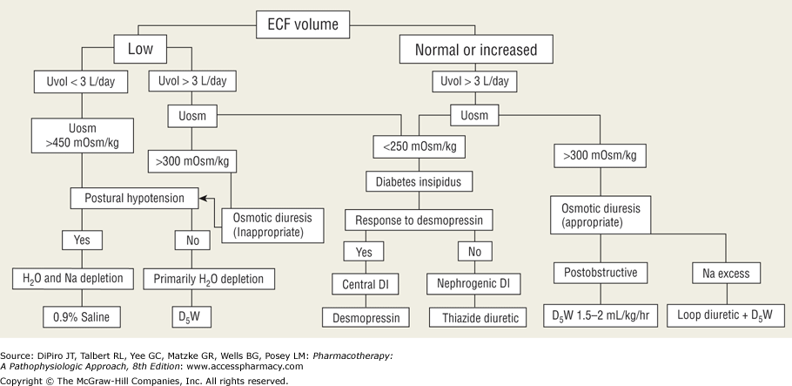
Diagnostic and treatment algorithm for the hypernatremia
Central DI- kidneys have a normal response to ADH; production of ADH
Nephrogenic DI- kidneys have a lack of response to ADH; normal ADH production
Notes:
22:00

Slide 94
Treatment of Hypernatremia
Correct (hypertonic) hypernatremic state
Assess volume status and urine osmolality
Manage underlying cause
  All reversible causes should be identified and corrected
Correct by 0.5- 1.0 mEq/L/hr or 10- 12 mEq/L/ day to prevent cerebral edema and convulsions
  Give fluids enterally if possible
  Use hypotonic fluids for correction
    If patient is hypovolemic treat the hypovolemia first
Monitor serum sodium every 2- 4 hours
Goal to decrease to 145 mEq/L
  Might take a couple of days to correct
Notes:
22:14

Slide 95
Case #10
CR is a 32 y/o construction worker who is brought to the ED by a co-worker after collapsing while digging a hole on the job site.
VS: BP 78/49 HR 132 T 37°C RR 20; serum Na+ 163 mEq/L.
Her physical exam is significant for cool, mottled extremities
What type of sodium disorder is CR presenting with?
How would you like to treat CR’s hypernatremia?
What is your goal sodium level in the next 24 hours?

Slide 96
Questions?

